Slide 1

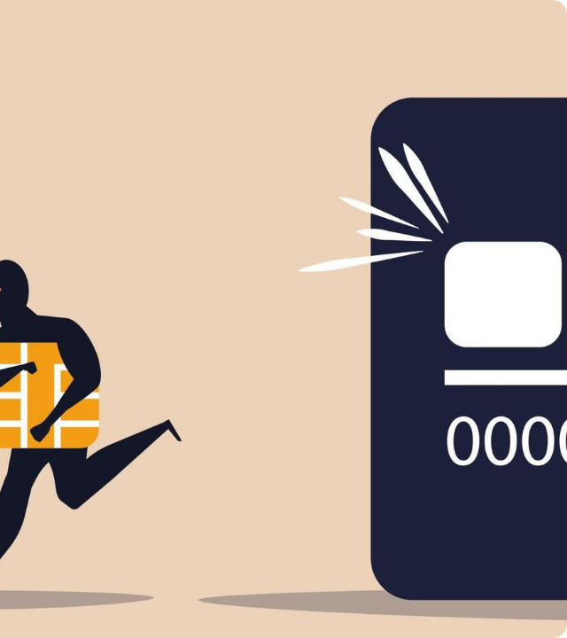
Credit Card
Fraud Detection
Project by: Adam Burke, Armin Soroosh, Luca Guerra
Introduction to Data Mining DATS 6103

Slide 2


The Problem
Financial Impact
Credit card fraud incurs billions in losses annually for banks and consumers. Traditional manual detection is too slow for modern transaction volumes.
Security First
The Objective
Our goal is to identify the "needle in the haystack" without blocking legitimate users.
To develop an automated machine learning model capable of detecting fraudulent transactions with high accuracy, specifically focusing on minimizing False Negatives.

Slide 3







Dataset Overview
https://www.kaggle.com/datasets/dhanushnarayananr/credit-card-fraud/data
1,000,000 rows and 8 columns
Continuous Numerical Features
Categorical (Binary) Features
Source
card_transdata.csv
•
Distance from home
•
Repeat Retailer
•
Distance from last transaction
•
Used Chip
Used PIN
A dataset from Kaggle containing transaction features and a binary target variable.
•
•
Ratio to median purchase price
Online Order
•
Fraud (0/1)
•

Slide 4
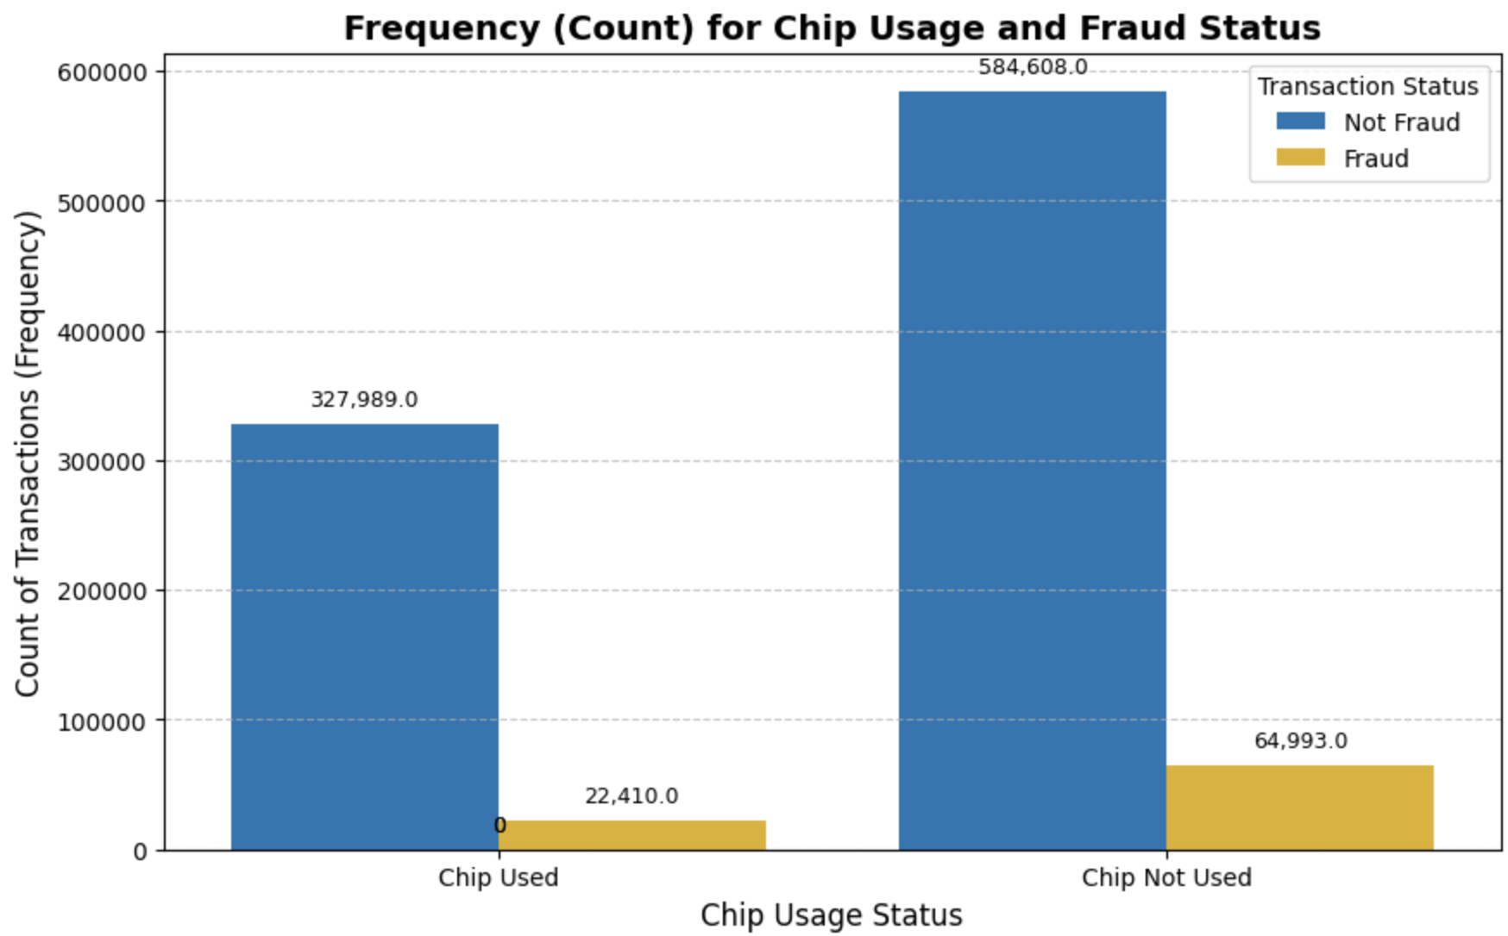
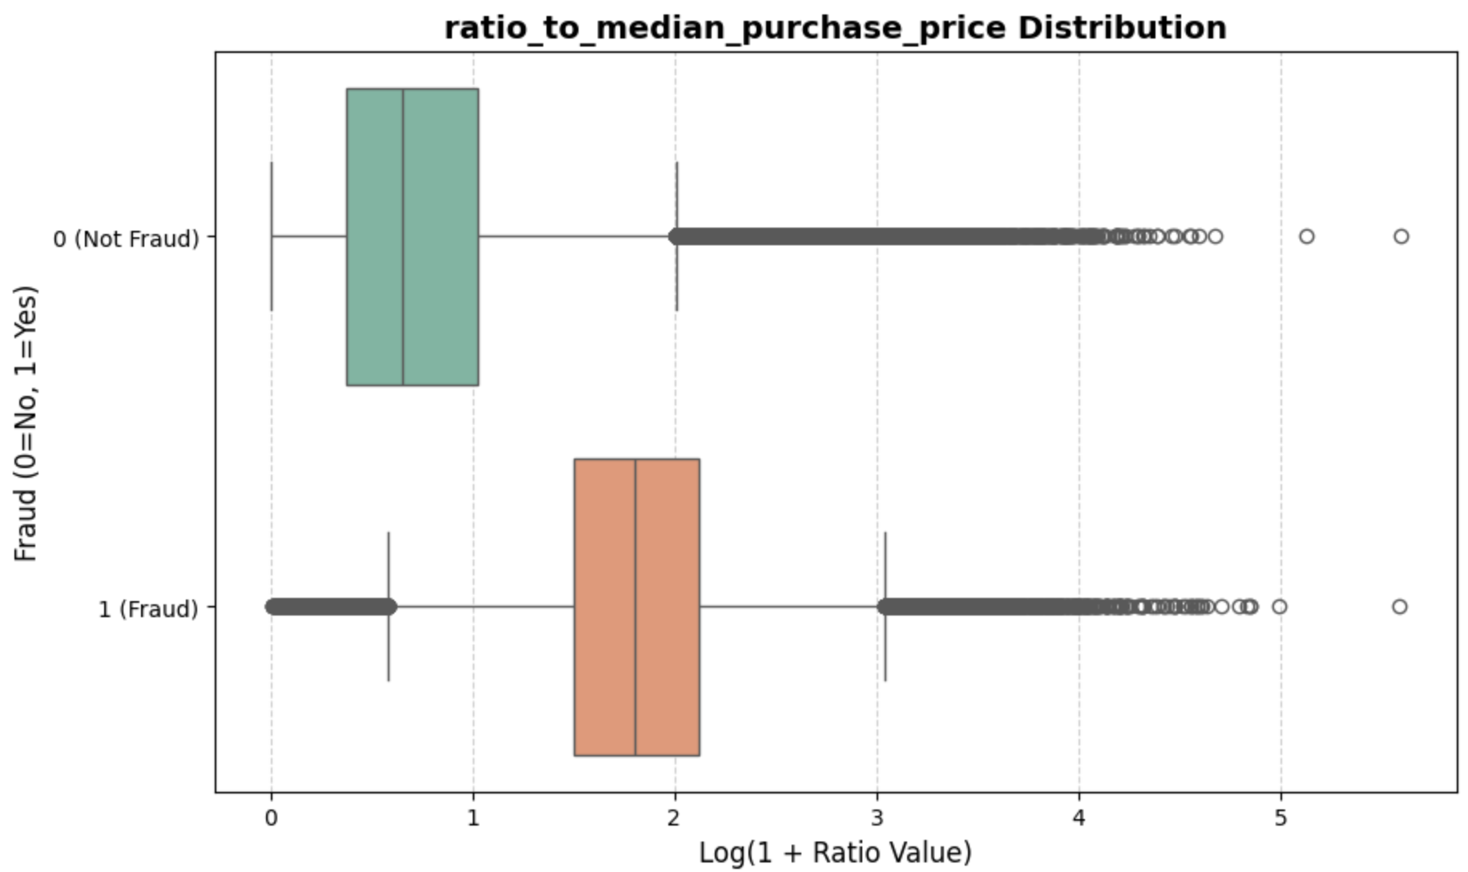
EDA
Chip Used: 0.068 fraud ratio
Chip Not Used: 0.111 fraud ratio

Slide 5

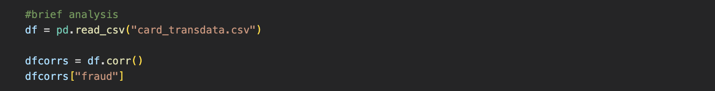
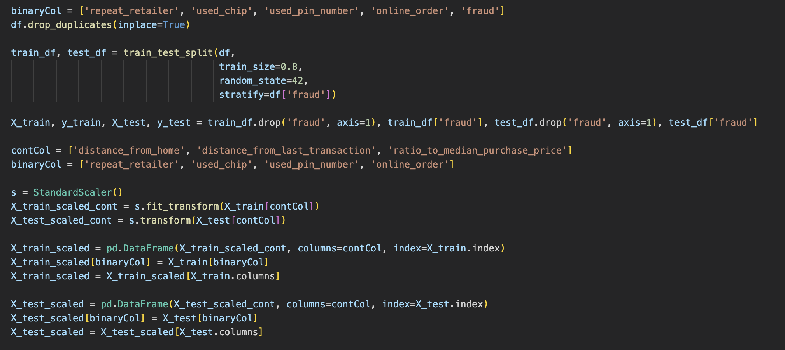
Preprocessing Pipeline
1. Cleaning
Removed duplicate entries to prevent data leakage and bias.
2. Type Casting
Converted binary columns to int8 for memory efficiency.
3. Stratified Split
Split data 80/20 while maintaining the ratio of fraud cases (Stratify = y).
4. Scaling
Applied StandardScaler to continuous variables to normalize distance and price ratios.

Slide 6







Methodology: Models Selection
Logistic Regression
Support Vector Machine (SVC)
A baseline linear model. Good for interpretability but assumes linear decision boundaries.
Attempts to find the optimal hyperplane separating fraud from non-fraud. Used with a linear kernel and balanced class weights.
Random Forest
Decision Tree
An ensemble of Decision Trees. Reduces variance and typically provides the highest accuracy for this type of tabular data.
Captures non-linear patterns by splitting data based on feature values. Can be prone to overfitting.

Slide 7


Results: Linear Models
Logistic Regression
SVM (Linear Kernel)
Performed reasonably well but struggled with complex fraud patterns.
S
Metric | Score
Precision (Fraud) | 0.89
Recall (Fraud) | 0.91
F1-Score | 0.90
Metric | Score
Precision (Fraud)
Recall (Fraud)
F1-Score

Slide 8

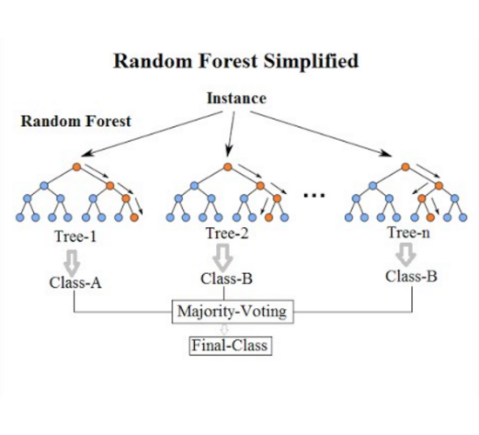


Results: Tree-Based Models
Tree-based models significantly outperformed linear models on this dataset.
Decision Tree
Near perfect accuracy, capturing the sharp thresholds in transaction rules.
Random Forest
Achieved 100% precision and recall on the test set, effectively eliminating false positives and negatives.

Slide 9
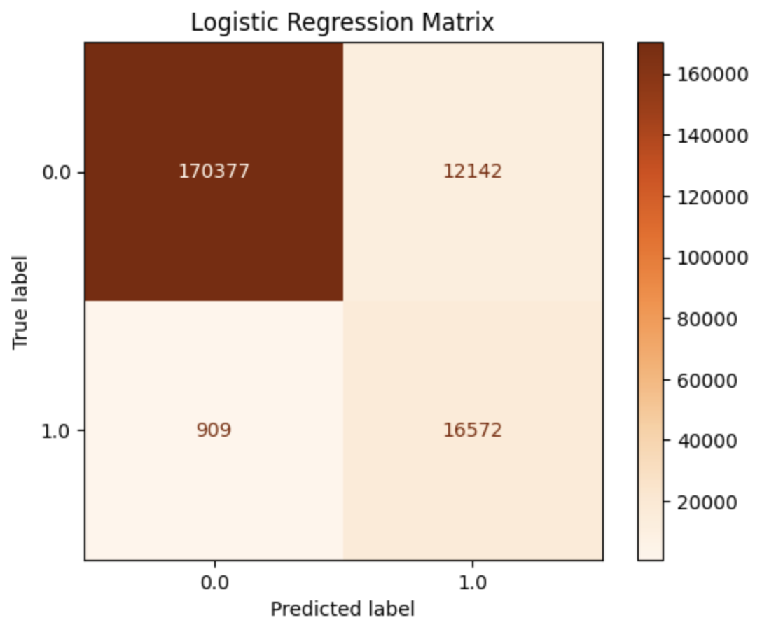
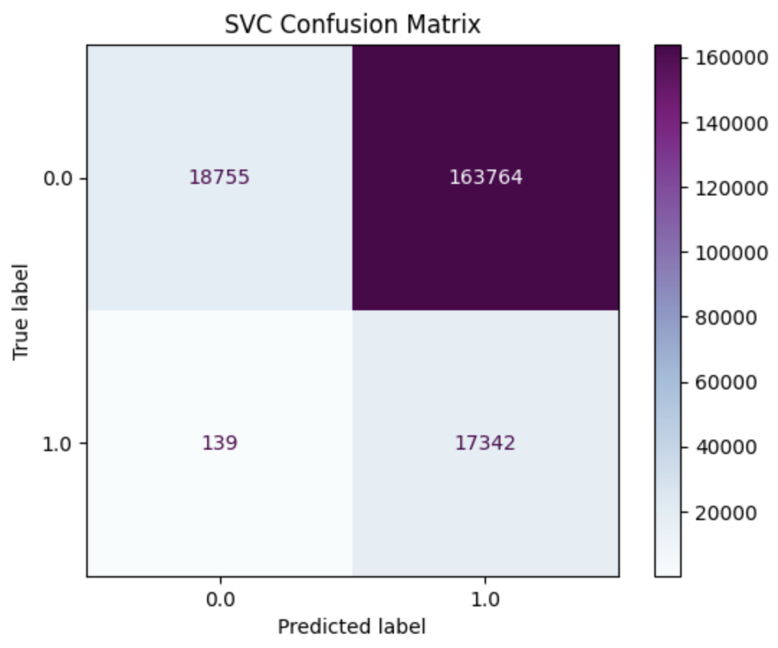
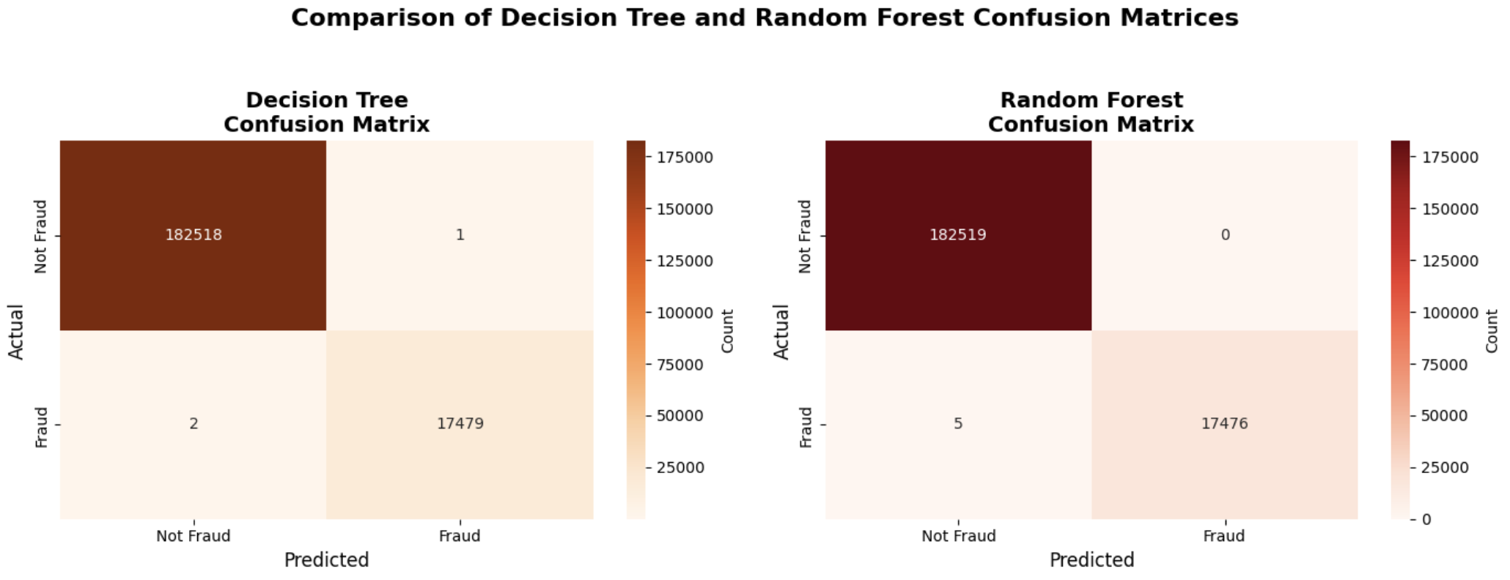
Confusion Matrix Analysis
Why it Matters
In fraud detection, accuracy isn't enough. We must look at:
False Negatives (FN)
Fraudulent transactions labeled as safe.
Cost: Direct financial loss.
False Positives (FP)
Safe transactions labeled as fraud.
Cost: Customer annoyance and blocked cards.
The Random Forest model minimized both errors to near zero.

Slide 10
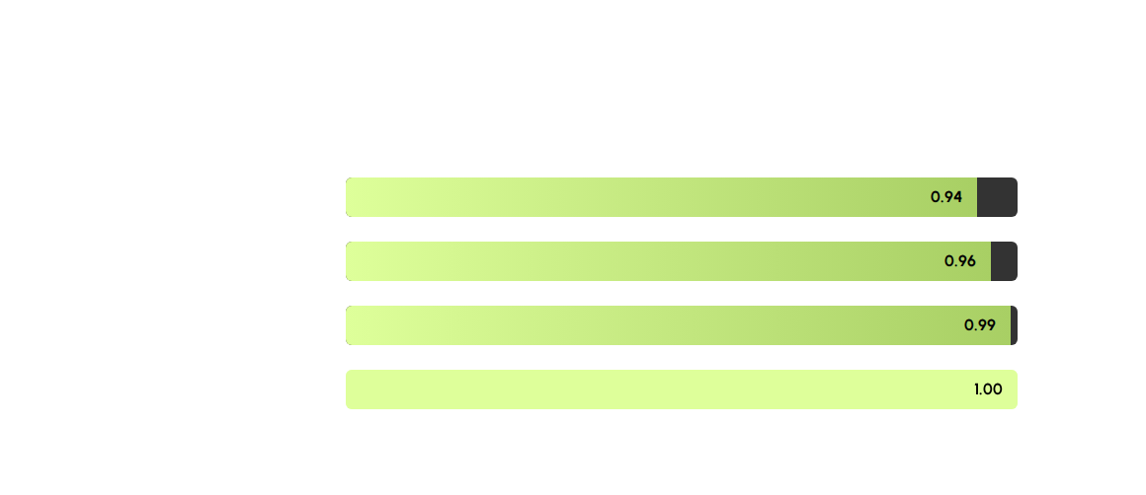
The Showdown: AUC Scores
Area Under the Curve (AUC) measures the ability of the classifier to distinguish between classes.

Slide 11






Key Findings
Random Forest Superiority
Importance of Scaling
Stratification
StandardScaler was crucial for the Logistic Regression and SVC models to converge, though Tree models were less affected.
Using stratify=df['fraud'] during the train-test split ensured our validation metrics were reliable and not skewed.
Random Forest was robust against the imbalance and handled the feature interactions (like Chip + Distance) perfectly.

Slide 12

Conclusion
The Random Forest classifier is the recommended model for deployment. It offers the highest protection against financial loss (Recall) while maintaining a seamless user experience (Precision).
Next Steps: Hyperparameter tuning and real-time API integration.

Slide 13
Q & A
Thank you for your attention.

Slide 14


Image Sources
https://static.vecteezy.com/system/resources/previews/010/869/687/non_2x/credit-card-phishing-with-money-and-identity-number-secure-data-protection-and-attack-online-illustration-concept-scam-privacy-finance-and-fraud-password-steal-bank-information-on-web-vector.jpg
Source: www.vecteezy.com
https://miro.medium.com/1*i0o8mjFfCn-uD79-F1Cqkw.png
Source: medium.com
https://www.kaggle.com/datasets/dhanushnarayananr/credit-card-fraud/data
Source: Kaggle.com

